Slide 1

Academic Session 2025-26
EVEN Semester Jan-Jun 2026
UNIVERSITY INSTITUTE OF ENGINEERING
AIT-CSE
B.E CSE
AIML/ 6th
SOFTWARE ENGINEERING
23CSH-374
Faculty Name : Dr Geeta Rani CUmail-ID : geeta.e15227@cumail.in
Designation : Associate Professor

Slide 2
Course Objectives
Understand fundamental software engineering processes, SDLC models, and requirement engineering techniques used in real-world projects.
Apply modeling concepts, design principles, and UML diagrams to represent system structures and behaviors effectively.
Analyze various software development, design, and testing strategies to determine their suitability for different project scenarios.
Evaluate software solutions and project management practices based on quality metrics, design principles, and testing outcomes.
Create structured requirement documents, UML models, test plans, and project management artifacts for medium-scale software systems.

Slide 3

Course Outcomes
CO No. | Statement
CO1 | Explain SDLC models, requirement principles, testing strategies, and project management concepts.
CO2 | Construct UML diagrams and apply design patterns to solve software design problems
CO3 | Compare SDLC models, testing strategies for different scenarios.
CO4 | Assess testing strategies, maintenance approaches, and project metrics to ensure software quality.
CO5 | Develop complete requirement specifications, design models, test plans, and project management documents (including Jira-based defect tracking) for real-world case studies

Slide 4
Suggestive Readings
Text Books:
Pressman, R. S., “Software Engineering: A Practitioner’s Approach,” McGraw Hill.
Ian Sommerville, “Software Engineering,” Pearson.
Reference Books:
Pankaj Jalote, “An Integrated Approach to Software Engineering,” Narosa.
Ghezzi, Jazayeri, Mandrioli, “Fundamentals of Software Engineering,” PHI.

Slide 5
Unit-I Syllabus
Unit-1 | Unit 1: Software Process and Requirement Engineering (15 hours)
Chapter 1.1 | Software Engineering: Introduction, SDLC, Agile vs Traditional models.
Chapter 1.2 | Requirement Engineering: Elicitation, Analysis, Specification, Validation.
Chapter 1.3 | Case Studies: Requirements in online payment systems.

Slide 6
2
Recap of Previous Lecture
Software Development Life Cycle (SDLC) is a process used by the software industry to design, develop and test high-quality software. The SDLC aims to produce high-quality software that meets or exceeds customer expectations, is completed within the estimated time and cost. Essential software product attributes are maintainability, dependability and security, efficiency, and acceptability.
The Software Development Life Cycle (SDLC) consists of seven essential phases: Planning, Requirements Analysis, Design, Coding, Testing, Deployment, and Maintenance, that ensure successful software development, from concept to continuous improvement.

Slide 7
Table of Contents
5
SDLC Models
Waterfall Model
Agile Model
Summary

Slide 8
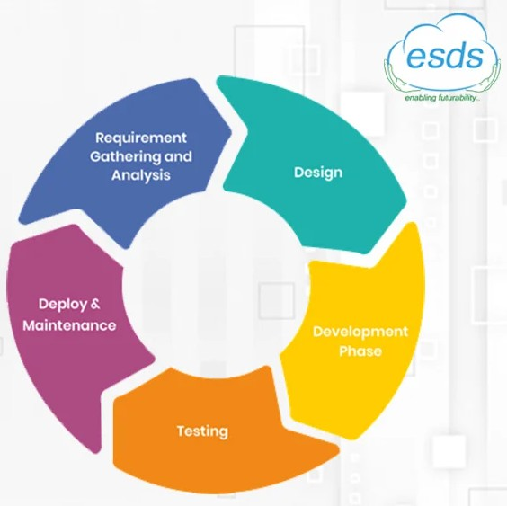
4
Software Development Life Cycle
SDLC stands for Software Development Life Cycle
A process for developing, designing, and maintaining a software project by ensuring that all the Functionalities along with user requirements, objectives, and end goals are addressed
With SDLC, the software project’s quality and the overall software development process get enhanced.

Slide 9
4
Popular SDLC Models
Waterfall model
Iterative model
Spiral model
V-shaped model
Agile model

Slide 10
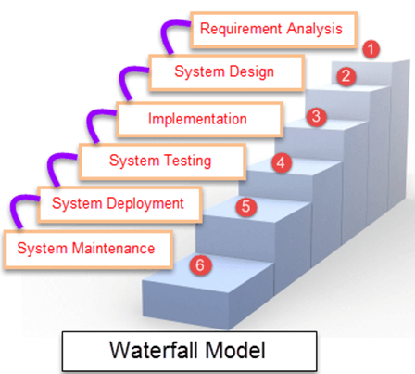
4
Waterfall model

Slide 11
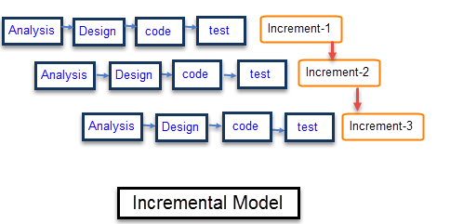
4
Software Development Life Cycle

Slide 12
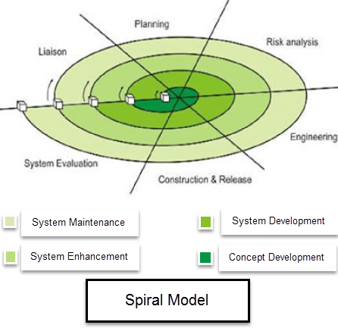
4
Software Development Life Cycle

Slide 13
Summary
7
The Software Development Life Cycle (SDLC) is a structured process used by development teams to design, build, test, and maintain high-quality software efficiently and cost-effectively. SDLC divides the software development process into distinct phases, each with specific goals and deliverables, ensuring systematic progress and continuous improvement.

Slide 14
8
Quiz/ FAQ’s
What are the main phases of the SDLC?
Why is the SDLC important in software engineering?
What is the purpose of the maintenance phase in SDLC?

Slide 15
10
Faculty-curated videos, NPTEL, Coursera, LinkedIn, or other relevant learning resources
NPTEL — “Software Engineering” course from IIT Kharagpur / Indian Institutes https://onlinecourses.nptel.ac.in/noc25_cs108/preview?utm_source=chatgpt.com
CS & IT Tutorials by Vrushali — “SE 1: Learn Software Engineering from Scratch” (YouTube) https://www.youtube.com/watch?v=IHx9ImEMuzQ
nptelhrd (IIT/Bombay) — Lecture series “Introduction to Software Engineering” (free video lecture) https://www.youtube.com/watch?v=Z6f9ckEElsU&utm_source=chatgpt.com
Coursera – Introduction to Software Engineering (IBM) https://www.coursera.org/learn/introduction-to-software-engineering

Slide 16
10
Next lecture
Agile software development and Their characteristic

Slide 17

11
Class-Wise Feedback

Slide 18
12
Thank You
For queries
Email: geeta.e15227@cumail.in

